Slide 1

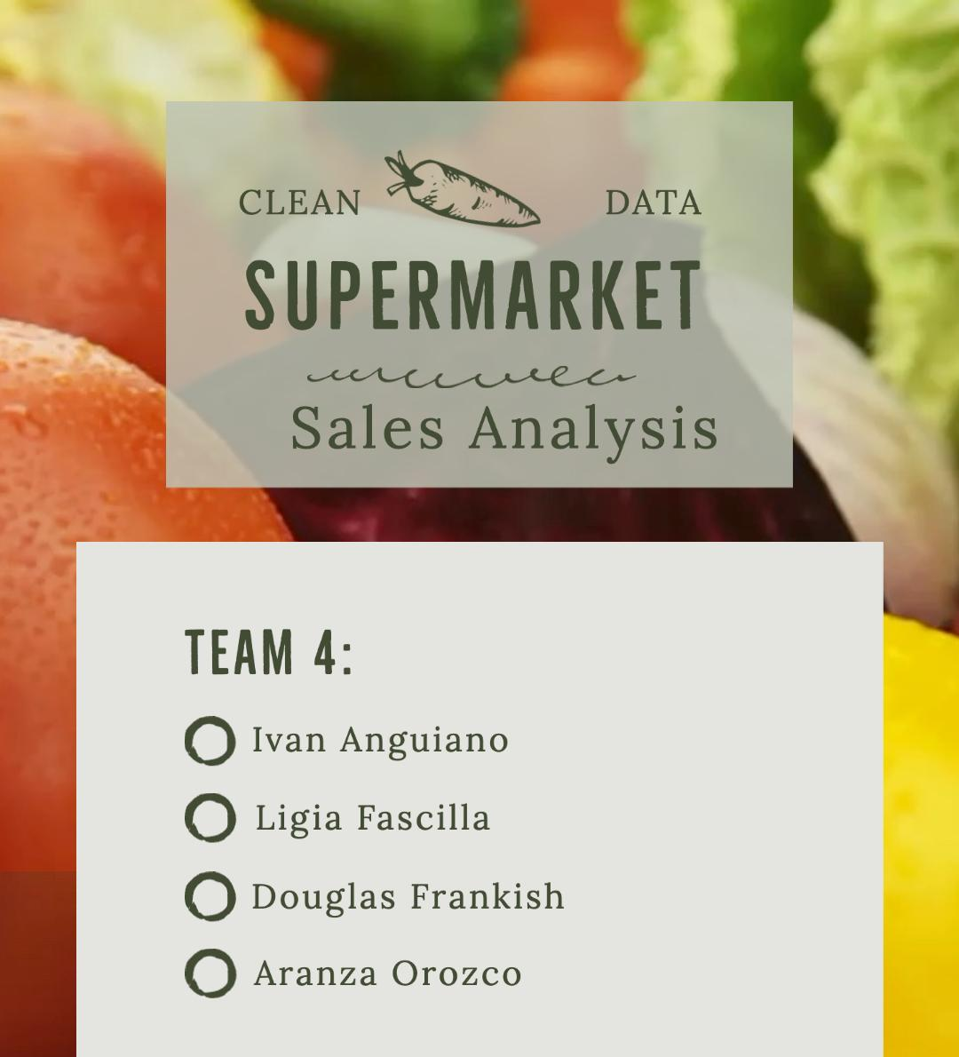

Slide 2
Overview
Dataset: https://www.kaggle.com/datasets/aungpyaeap/supermarket-sales
Dataset consists of historical data from a supermarket that recorded sales from three different branches for three months.

Slide 3
Data Structure - Columns
Invoice id: Computer generated sales slip invoice identification number
Branch: Branch of supercenter (3 branches are available identified by A, B and C).
City: Location of supercenters
Customer type: Type of customers, recorded by Members for customers using member card and Normal for without member card.
Gender: Gender type of customer
Product line: General item categorization groups - Electronic accessories, Fashion accessories, Food and beverages, Health and beauty, Home and lifestyle, Sports and travel
Unit price: Price of each product in $
Quantity: Number of products purchased by customer
Tax: 5% tax fee for customer buying
Total: Total price including tax
Date: Date of purchase (Record available from January 2019 to March 2019)
Time: Purchase time (10am to 9pm)
Payment: Payment used by customer for purchase (3 methods are available – Cash, Credit card and Ewallet)
COGS: Cost of goods sold
Gross margin percentage: Gross margin percentage
Gross income: Gross income
Rating: Customer stratification rating on their overall shopping experience (On a scale of 1 to 10)

Slide 4
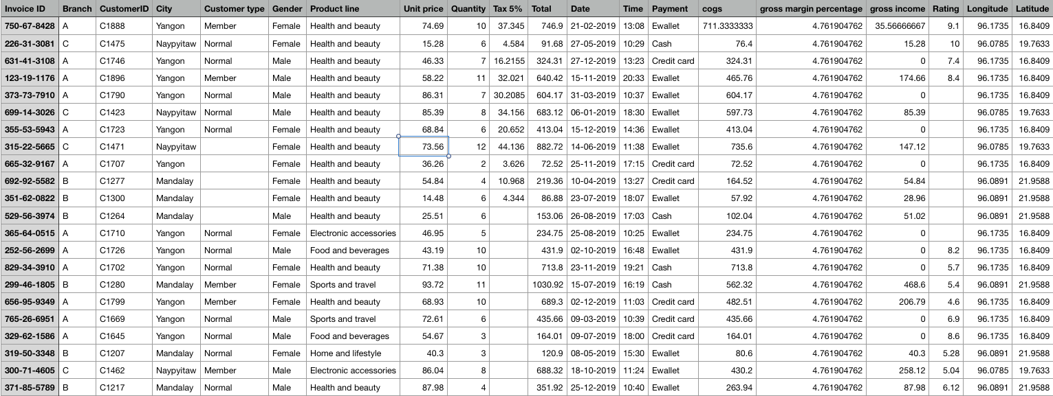
Dataset Snapshot

Slide 5
Questions
What is the difference in spending patterns between male and female customers? Do they tend to buy different products? What is the relationship between gender and payment type?
4
Which branch has the highest sales volume and revenue?
1
What is the correlation between customer rating and total purchase amount? Is there a relationship between purchase time of day and customer rating?
What is the average unit price and quantity of products purchased? Is there a relationship between the unit price and the quantity purchased?
5
2
What is the percentage of sales from members compared to non-members? Is there a difference in spending patterns between members and non-members? What is the relationship between customer type and payment type?
Which payment method is the most popular among customers? Is there a difference in spending patterns based on the payment method used?
3
6

Slide 6
Question
01
What is the difference in spending patterns between male and female customers? Do they tend to buy different products? What is the relationship between gender and payment type?

Slide 7
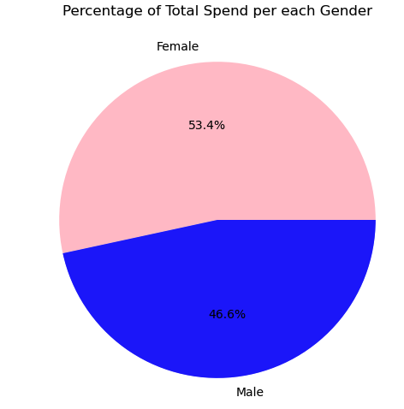
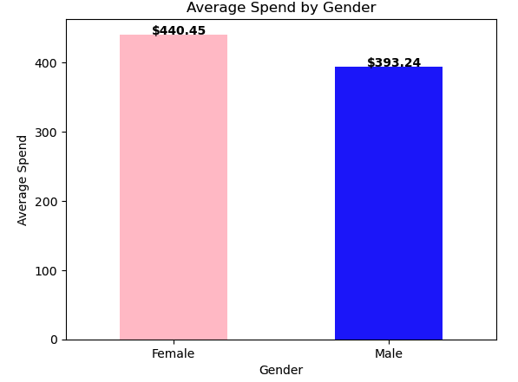
Question
01
Part 1: Total Spend by Gender and Average Spend by Gender
Process:
Data clean-up: dropped rows with no Invoice ID, Gender or Total
Verify data validity/representativeness: 493 females and 482 males left
Find total spend using .groupby.(‘Gender’)[‘Total’].sum()
Find average spend using same formula but with .mean()
Analysis/Conclusion of Part 1:
Overall, females spent more money than males. Not only in total spend for the three months analyzed, but also on average spend per female/male. Females spent 53.4% out of the total spend. There were also more females than males, but the difference was only by 11 individuals. (Females total spend: $217,141.20. Males total spend: $189,539.62)

Slide 8
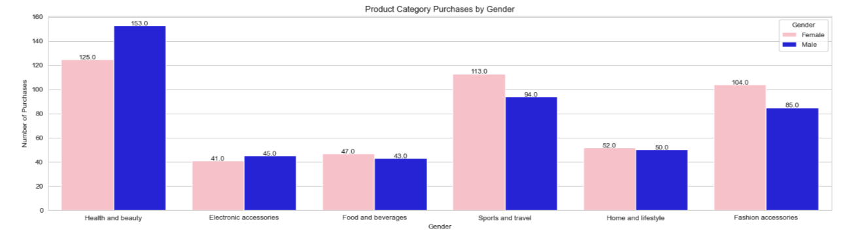
Question
01
Part 2: Product Line Purchases by Gender
Process:
Data clean-up: dropped rows with no Invoice ID, Gender or Product Line
Verify data validity/representativeness: 482 females and 470 males left
Find product line purchases by gender using .groupby('Gender')['CustomerID'].count()
Analysis/Conclusion of Part 2:
More males than females shopped in the 'Health and Beauty' category, and in the 'Electronic Accessories' category. The 'Health and Beauty' category is where most men shopped at. Females surpassed males in shopping the 'Fashion Accessories' and 'Sports and travel' categories by the same amount (19), and did not surpass them in the 'Home and Lifestyle' and 'Food and Beverages' categories by much.

Slide 9
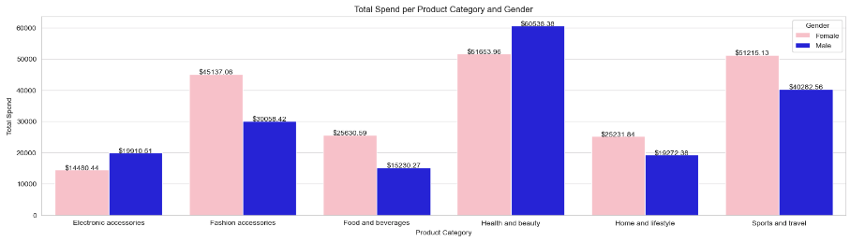
Question
01
Part 3: Total and Average Spend per Product Line by Gender
Process:
Data clean-up: dropped rows with no Total, Gender or Product Line
Find total spend per product line by gender using .groupby(['Product line', 'Gender'])['Total'].sum().reset_index()
Find average spend per product line by gender using the same code but with the mean of total spend per product line per gender
Analysis/Conclusion of Part 3:
Both genders spent the most in the line 'Health and Beauty' in total. Females spent the most on average in the 'Food and Beverages' line ($545.33) while men spent the most on average in the 'Electronic Accessories' line ($442.46).

Slide 10
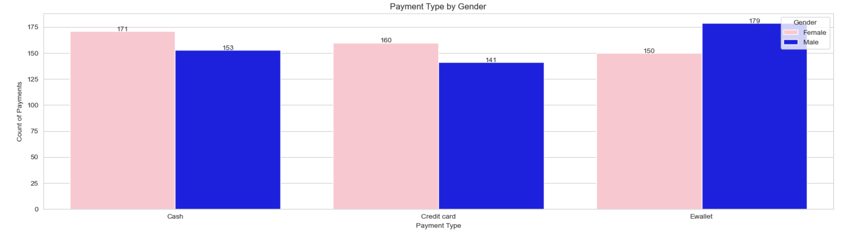
Question
01
Part 4: Relationship Between Payment Type and Gender
Process:
Data clean-up: dropped rows with no Invoice ID, Gender or Payment
Verify data validity: 481 females and 473 males left
Find total purchases per payment type by gender using .groupby(['Gender', 'Payment'])['Invoice ID'].nunique().reset_index()
Analysis/Conclusion of Part 3:
Males paid the most using Ewallets and the least using Credit Cards, while females paid the most using Cash and the least using Ewallets.

Slide 11
Question
02
What is the average unit price and quantity of products purchased? Is there a relationship between the unit price and the quantity purchased?

Slide 12
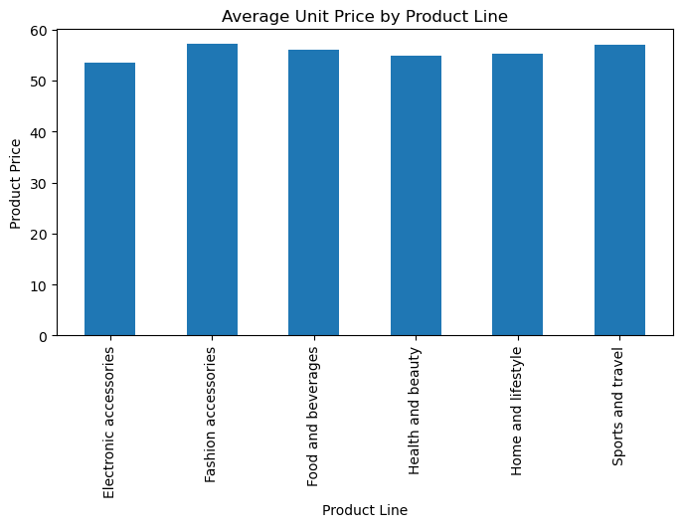
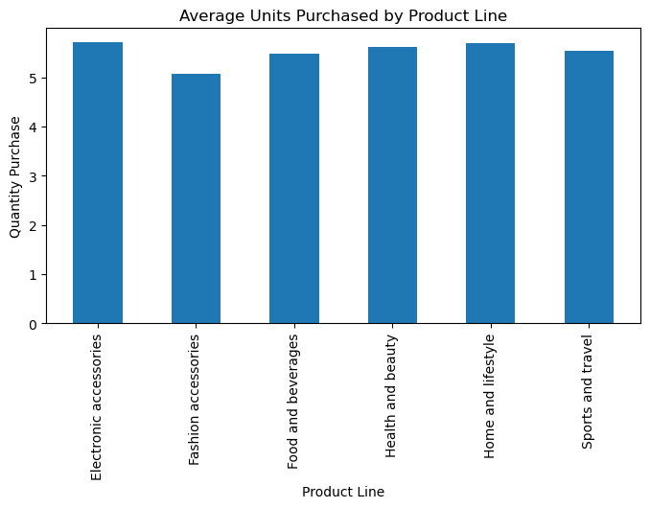
Question
02
Process:
Narrowed down both sets of results using groupby (‘Product line’) [Unit Price/Units]. mean() for the averages.
Average unit price: $55.67 (overall)
Average quantity purchased: 5.51
Analysis
While there appears to be some dips in the quantity prices and among the average unit prices, they are actually quite consistent, with a range of $3.60 for product price and 0.65 for quantity purchased.

Slide 13
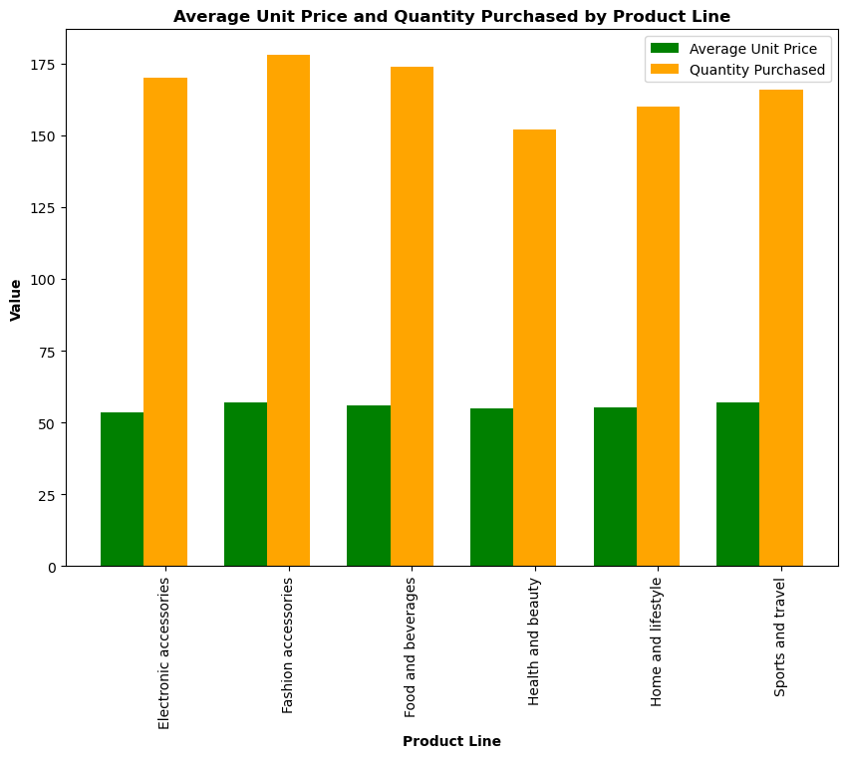
Question
02
Process:
Again using groupby(‘Product line’)[Unit Price/Units]. mean()- Compared the average unit price with the actual quantity purchased (vs the average)
Quantity Purchased Average Unit Price
Electronic accessories 170 55.55
Fashion accessories 178 57.15
Food and beverages 174 56
Health and beauty 152 54.85
Home and lifestyle 160 55.31
Sports and travel 166 56.99
Analysis:
There is a pretty consistent line across the average unit price and the quantity purchased. With a quantity range of 26 between Fashion and Health and Beauty, people appear to be buying what they want and how much of it they want.

Slide 14
Question
03
What is the percentage of sales from members compared to non-members? Is there a difference in spending patterns between members and non-members? What is the relationship between customer type and payment type?

Slide 15
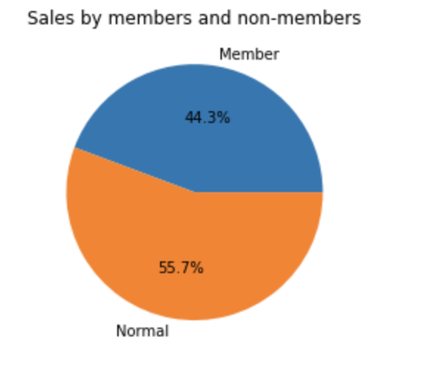
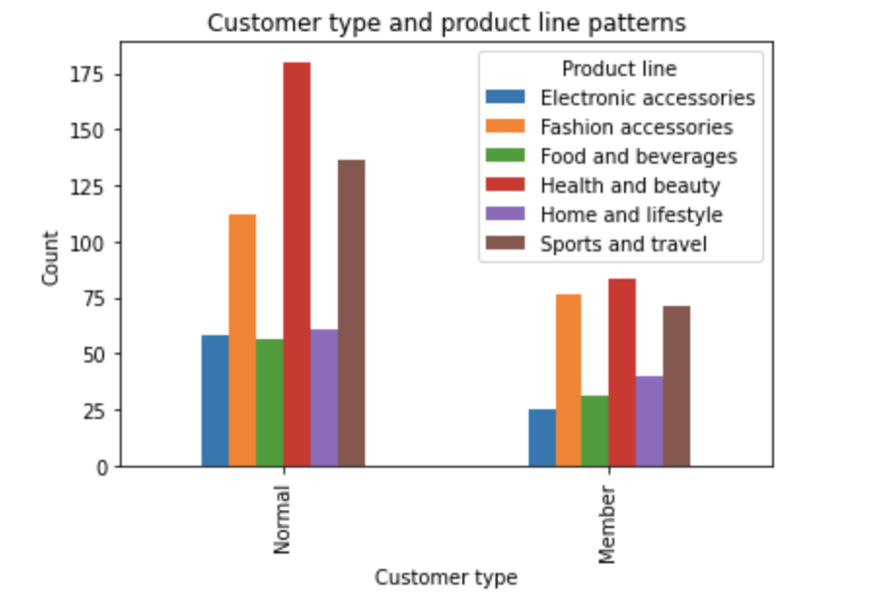
Question
03
Part 3: Members and Non-members
The number of sales for each customer type was added, each of the sales in every product line for each customer, and each payment method used by each customer group.
Analysis: Almost half of the sales are made by members. The spending patterns are very similar between members and non-members. Members prefer to pay with credit card while the non-members prefer to pay with Ewallet
.

Slide 16
Question
04
Which branch has the highest sales volume and revenue?

Slide 17
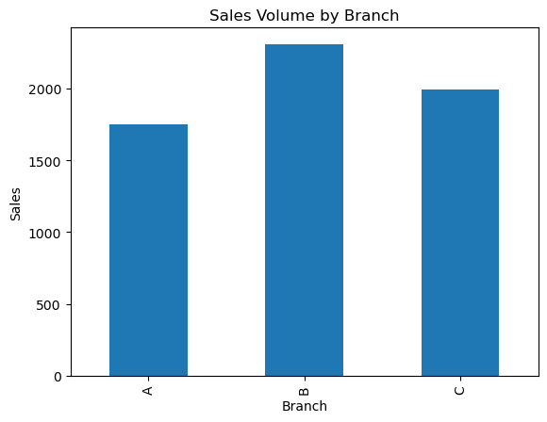
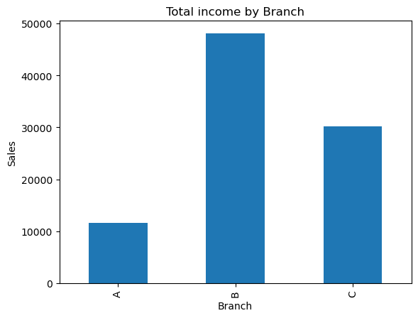
Question
04
Process:
Grouped the data in a dataframe by the values in the Branch column
Selected the gross income and sales columns and calculated the sum of its values for each group
Which branch has the highest sales revenue?
Branch B with $48,094
Which branch has the highest sales volume?
Branch B with 2307 sales

Slide 18
Question
05
What is the correlation between customer rating and total purchase amount? Is there a relationship between purchase time of day and customer rating?

Slide 19
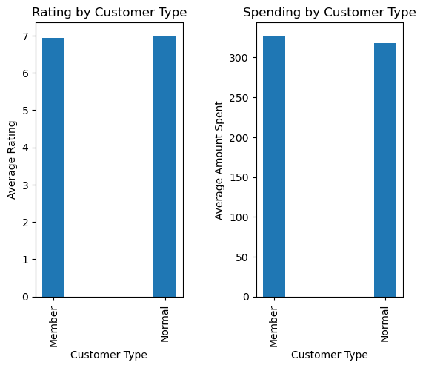
Question
05
Process:
To make the results a little more interesting visually- rather than just showing the average rating vs amount spent, displayed is the rating/spent by customer type.
Information gathered using groupby(‘Customer Type)[‘Rating/Total’).mean
What is the correlation between customer rating and total purchase amount?
Member Rating: 6.940319
Normal Rating: 7.005210
Member Spending: $327.79
Normal Spending: $318.12
Analysis:
Customers like this supermarket. The ratings are nearly the same whether a member or normal customer, and with less than a $10 difference, spending averages are also on par.

Slide 20
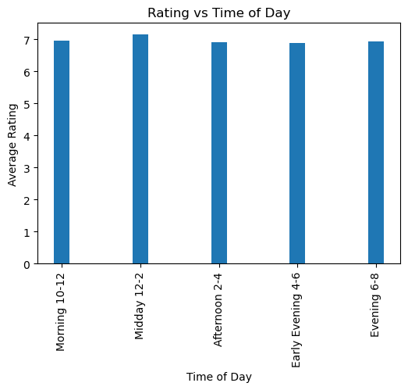
Question
05
Process:
Bins and pd.cut were used to classify the ratings into groups based on the time of day
Morning: 6.96
Midday: 7.15
Afternoon: 6.9
Early Evening: 6.89
Evening: 6.94
Analysis:
There is not a significant difference in when customers shop. Once again, the ratings remain extremely consistent throughout the day.

Slide 21
Question
06
Which payment method is the most popular among customers? Is there a difference in spending patterns based on the payment method used?

Slide 22
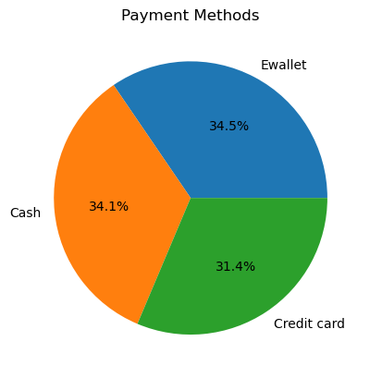
Question
06
Process:
Used the str.contains.sum() function to count the number of occurrences of each payment method in the Payment column.
For the pie chart, we used the .value_counts() function to count the number of occurrences of each unique word. We then used plt.pie()
Which payment method is most popular amongst customers?
EWallet is the most popular with 338 sales. But Cash is really close with 334 sales.

Slide 23
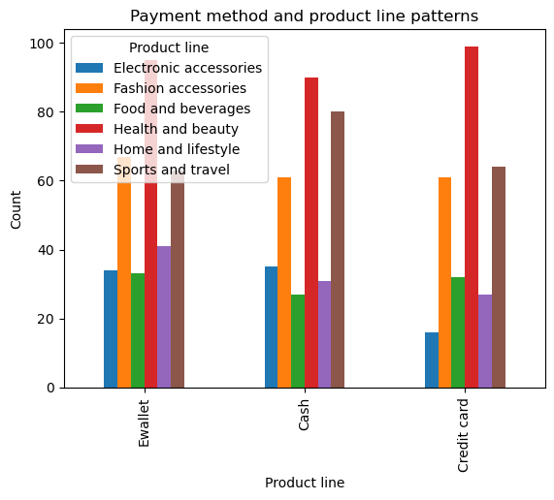
Question
06
Process:
Used the groupby function to count the occurrences of each payment method and product line combinations
Sorted them by the total count of each payment method
Plotted the sorted counts using a bar plot.
Are there any spending patterns based on the payment method used?
Health and beauty is the most popular product line
For Sports and travel, Cash is more frequently used
People prefer to use Ewallet for Home and lifestyle accessories
Credit card is by far the least popular payment method for electronic accessories

Slide 24
Thank you.

